Slide 1
Introduction to Demography
Anuradhani Kasturiratne MBBS, MSc, MD
Senior Lecturer in Public Health

Slide 2
Learning outcomes
To define demography
To describe factors affecting population dynamics
To describe sources of demographic data
To describe the use of demographic data for health

Slide 3
Definition
Study of human population dynamics.
Includes the study of the size, structure and distribution of populations, and how populations change over time due to births, deaths, migration, and aging.

Slide 4
Factors affecting population size
Births (fertility)
Deaths (mortality)
Migration

Slide 5
Crude Birth Rate
CBR = Total Number of live births/ Total population (expressed per 1000 population)

Slide 6
Crude Death Rate
CDR= Total Number of deaths/ Total population (expressed per 1000 population)

Slide 7
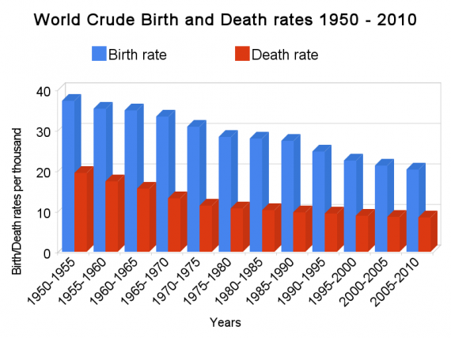

Slide 8
Natural increase
Births and deaths are natural causes of population change.
The difference between the birth rate and the death rate of a country or place is called the natural increase.
The natural increase is calculated by subtracting the death rate from the birth rate.
It does not take into account net migration
(In migration-out migration)

Slide 9
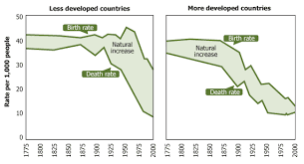
Natural Increase

Slide 10
Migration
The movement by people from one place to another with the intentions of settling, permanently or temporarily in a new location.
International migration: migration from one country to another.
Internal migration: migration within the same country

Slide 11
Migration
economic migration - moving to find work or follow a particular career path
social migration - moving somewhere for a better quality of life or to be closer to family or friends
political migration - moving to escape political persecution or war
environmental causes of migration include natural disasters such as flooding

Slide 12
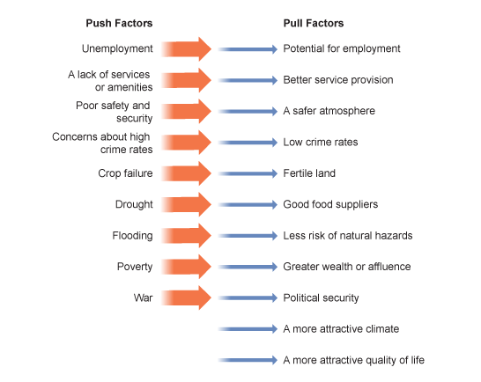
Migration

Slide 13
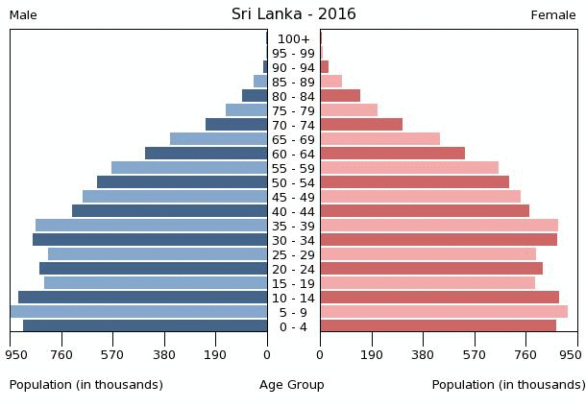
Population Structure

Slide 14
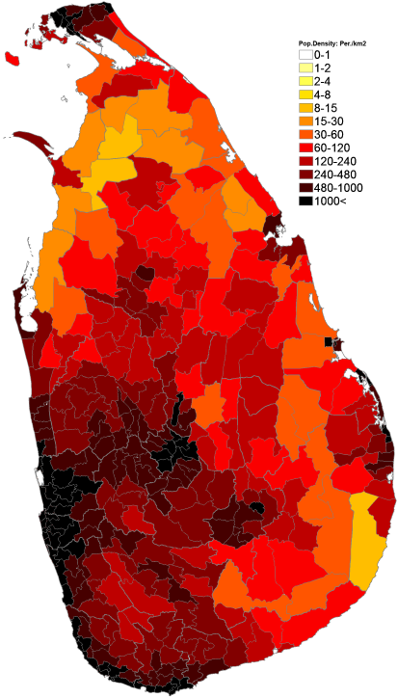
Population Distribution
Population density map of Sri Lanka
Population Density = Population/ Land area

Slide 15
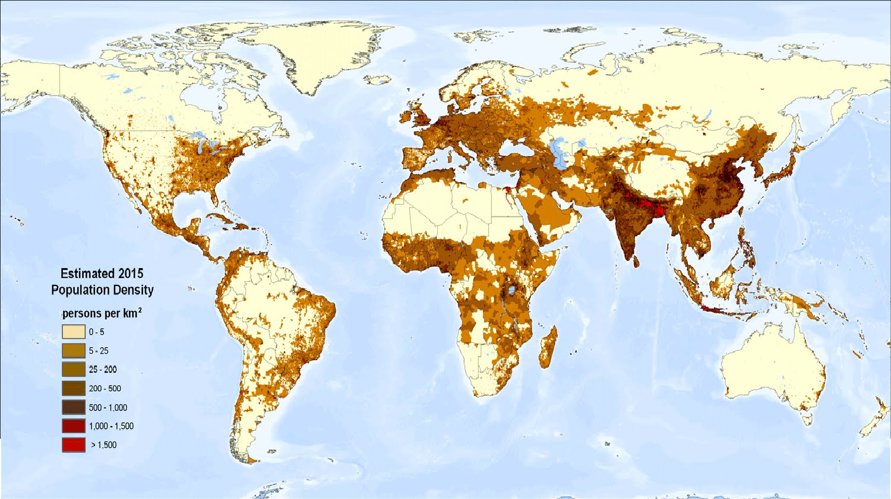

Slide 16
Sources of demographic data
Census
Demographic sample surveys e.g. DHS
Vital statistics (Births, deaths and marriages)
Health statistics
Migration statistics (immigration, emigration)
Labour statistics
School statistics

Slide 17
Uses of demographic data
To plan and provide services e.g. health, education, employment
To estimate the facilities required e.g. housing, water, transport
To determine emerging health problems and find solutions

Slide 18
World population distribution
https://www.indexmundi.com/facts/indicators/SP.POP.TOTL

Slide 19
Watch video
https://www.youtube.com/watch?v=RLmKfXwWQtE

